Slide 1

Turin
Museum Card Subscriptions Data Visualization
-
Main Results and Recommendations
By Rubiya Riaz
Academic Year 2018/2019

Slide 2
THE SCOPE OF THE ANALYSIS
Data Preparation and Constraints
Sources
Around 87,000 customers,
28 variables
And around 0.5million visits
Cardholder Information
Customer Visits(2013)
Customer Churn(2014)
01
03
Few Important variables
Importo
Sesso
Data Nascita
Comune
Churn
Constraints
Data cleaning and preparation
Data Size
Missing values
Missing coordinates
01
03
Basic Tools Used
Rprogramming in RStudio
SQL library in RStudio
01
Visualization
03

Slide 3
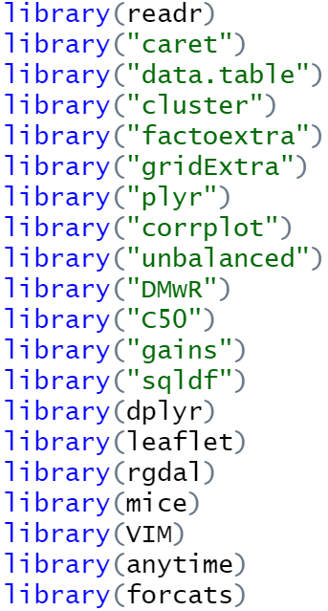
Setting up environment
-install R and Rstudio
-create R project and set working directory (wd)
-install and load relevant libraries for SQL, date-time
manipulation, plotting, maps..
install.packages(“library_name”)
library(library_name)
-import dataset in .csv format to the work directory

Slide 4
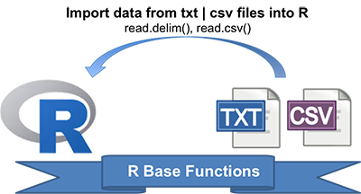
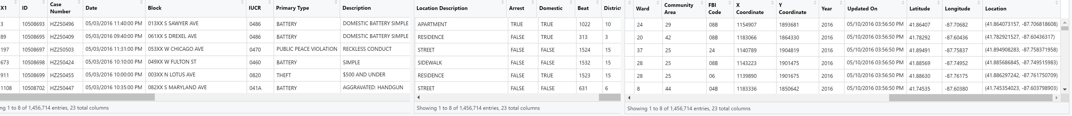
READING DATA
-read CSV in RStudio
an13<-read.csv("an13.csv",header=TRUE)
in13<-read.csv("in13.csv",header=TRUE)
data1<-read.csv("data1.csv",header=TRUE)

Slide 5
Cleaning Data And Adding New Columns
1
Imputing missing geographical points
2
Remove strange levels
Check for NAs: colSums(is.na(an13))
colSums(is.na(in13))
colSums(is.na(data1))
-Drop small number of rows containing ‘1-01’, ‘9-02’
-Drop rows with data nascita that gives age greater than 90
-Convert Data Nascita to Age Groups
-Where Importo=0, change tipo pagemento to Nussun Pagamento
-Fixing relevant column structure by checking using str()
-More columns were added as will be seen during the analysis
With this method:
Imputing Sesso using kNN imputation technique
Dropping profession column with all Null Values
Improvement in ease of analysis

Slide 6
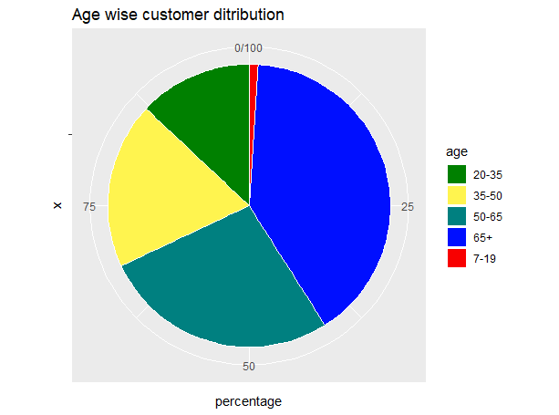
Primary Analysis
Discovery during primary analysis…
-Highest percentage of customers lie in the age of 65+
-Least popular is teenager group
-top crimes include theft, battery, criminal damage, narcotics
SQL code:
q1<-sqldf("select count(codcliente) AS freq, age from an5
group by age
order by freq")
ggplot code with layers:
ggplot(q1, aes(x = "", y = percentage, fill = age)) +
geom_bar(width = 1, stat = "identity", color = "white") +
coord_polar("y", start = 0)+
scale_fill_manual(values = mycols) +
labs(title="Age wise customer ditribution")
theme_void()

Slide 7
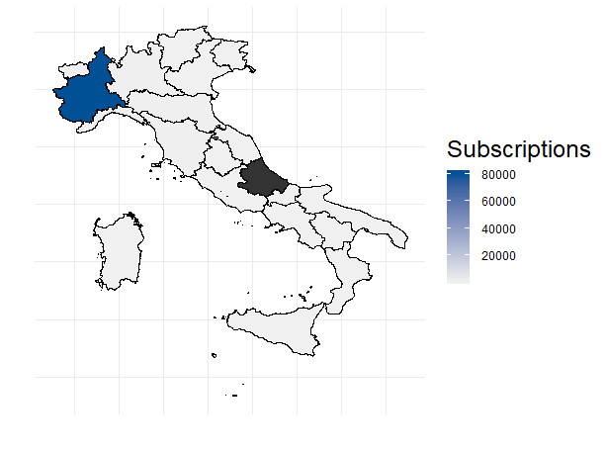
Primary Analysis Continued
-Highest number of customers live in the Piemonte Region
SQL code flow:
-Select customer frequency based on comune
-Join with data available on internet for regione nel Italia
-Group by regione
-plot4<-sqldf("select sum(frequency) AS Subscriptions,Abruzzi from plot3 group by Abruzzi order by Subscriptions DESC")
install_github("quantide/mapIT")
library(mapIT)
mapIT(Subscriptions, Abruzzi, data=plot4, guide.label="Number of subscriptions")

Slide 8
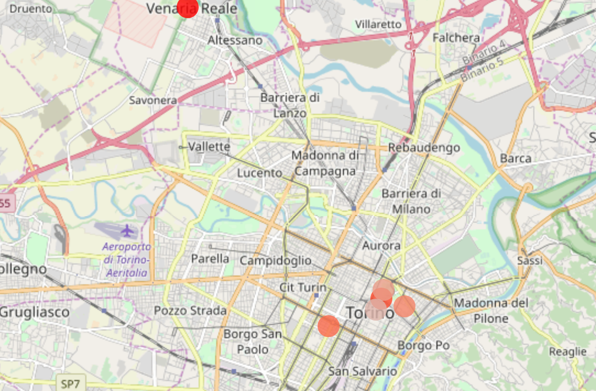
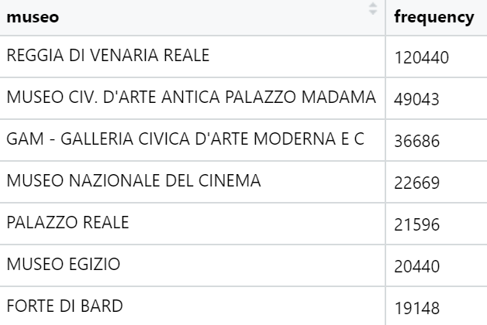
Primary Analysis Continued
List of highest visited museums
Most museums located in a cluster
Red to Grey color palette with red representing highest frequency
Museimap //contains all coordinates
colrange <- colorRampPalette(colors = c("grey80", "red"), space = "Lab")(7)
plot(rep(1,7),col=colrange,pch=19,cex=3)
mypal <- colorFactor(palette = colrange, domain = museimap$frequency)
leaflet() %>% addTiles() %>%
addCircleMarkers(data = museimap,
lat = ~mlat, lng = ~mlon,
color =~mypal(frequency) ,stroke = FALSE, fillOpacity = 0.8)
SQL code flow:
mfreq<-sqldf("select museo,count(*) AS frequency from in13
group by museo
order by frequency DESC
Limit 7")
Create dataframe containing coordinates of these selected museums and plot on map

Slide 9
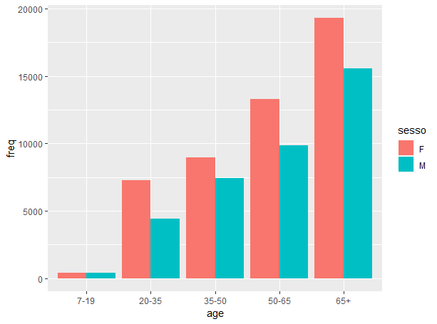
Secondary Analysis
Setting customer age range as the basis, we check to see how is gender distributed in the population
In all age categories, number of females was more than males.
In the young adult 20-35 group, females are double
SQL code:
q2<-sqldf("select count(codcliente) AS freq, age, sesso from an5
group by age, sesso
order by freq, sesso")
ggplot(q2, aes(fill=sesso, y=freq, x=age)) +
geom_bar(position="dodge", stat="identity")

Slide 10
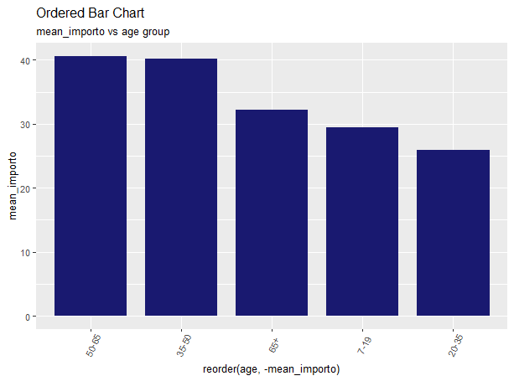
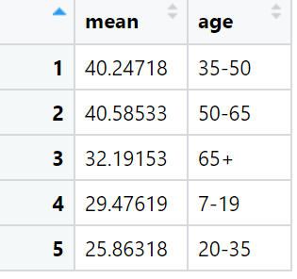
Secondary Analysis Continued
Mean import payment of each age group
The highest paying groups were 35-50,50-65
The least paying were teenagers and young adults
SQL code:
q3<-sqldf("select AVG(importo) AS mean, age from an5
group by age
order by importo DESC")
ggplot(q4, aes(x=reorder(age, -mean_importo), y=mean_importo)) +
geom_bar(stat="identity", width=0.8, fill="#191970") +
labs(title="Ordered Bar Chart",subtitle="mean_importo vs age group")+
theme(axis.text.x=element_text(angle=65, vjust=0.6),
text = element_text(size=10))

Slide 11
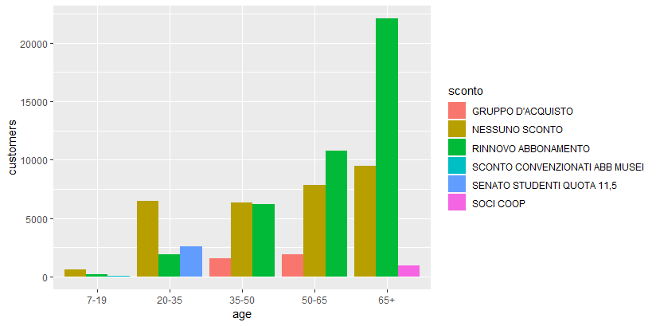
Secondary Analysis Continued
Visualizing top 3 sconto categories for each age group
Rinnovo abbonamento and nessuno sconto were the most popular
In the 20-35 age group, senato student quota was also quite popular
SQL code:
q5<-sqldf("select count(*) AS customers, sconto, age from an5
group by sconto, age
order by age, customers DESC")
q51<-sqldf("select * from q5 where age='7-19' limit 3")
q52<-sqldf("select * from q5 where age='20-35' limit 3")
q53<-sqldf("select * from q5 where age='35-50' limit 3")
q54<-sqldf("select * from q5 where age='50-65' limit 3")
q55<-sqldf("select * from q5 where age='65+' limit 3")
q6<-rbind(q51,q52,q53,q54,q55)
ggplot(q6, aes(fill=sconto, y=customers, x=age)) +
geom_bar(position="dodge", stat="identity")

Slide 12
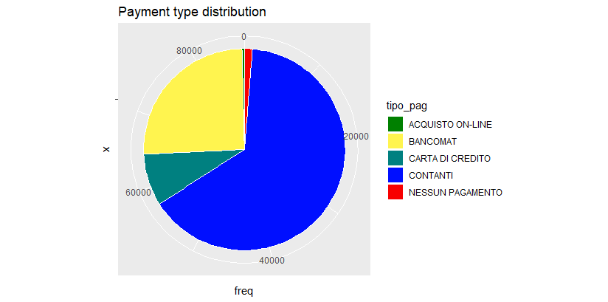
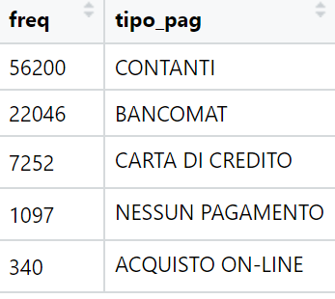
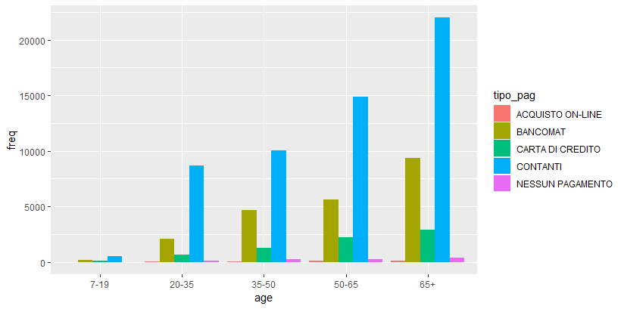
Secondary Analysis Continued
Most popular payment method piechart
Contanti was the most popular payment method followed by bancomat and carta di credito
Least popular was acquisito on-line which might be because of a lack of online development or marketing
This trend holds across all age groups as well.
SQL code:
q7<-sqldf("select count(*) AS freq, tipo_pag from an5 group by tipo_pag
Order by freq DESC")
q8<-sqldf("select count(*) AS freq, tipo_pag,age from an5 group by tipo_pag, age
Order by age DESC, freq DESC")
ggplot(q6, aes(fill=sconto, y=customers, x=age)) +
geom_bar(position="dodge", stat="identity")
ggplot(q8, aes(fill=tipo_pag, y=freq, x=age)) +
geom_bar(position="dodge", stat="identity")

Slide 13
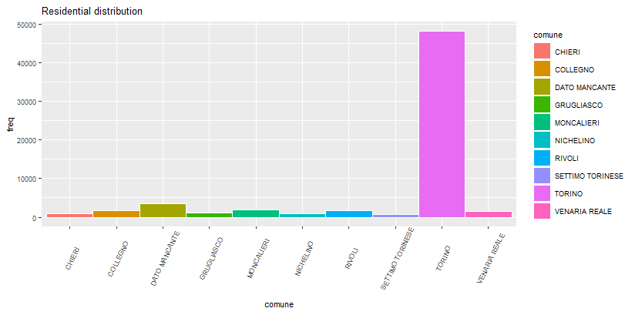
Secondary Analysis Continued
Customer distribution based on Comune
Maximum customers belong to commune di Torino
Dato Mancato comes as second highest but we chose not to remove or impute this category in order to maintain the data balance as it is.
SQL code:
q9<- sqldf("select comune, count(*) as freq
from an5
group by comune order by freq DESC
limit 10")
ggplot(q9, aes(x = comune, y = freq, fill = comune)) +
geom_bar(width = 1, stat = "identity", color = "white") +
labs(title="Residential distribution")+
theme(axis.text.x=element_text(angle=65, vjust=0.6),
text = element_text(size=8))

Slide 14
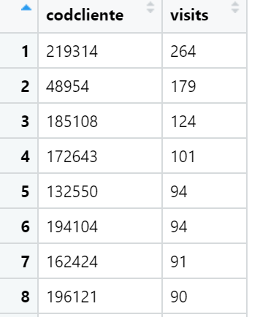
Secondary Analysis Continued
Number of visits per customer
Maximum customer visit was 264, Minimum was 1.
Average visits per person was 7
Checking the difference in rows from an5 and i1, we know 9000 people did not visit any place
We fix this later using joins
Analysis method:
We use the file in13.
Combine orari,datai columns as characters and then convert to time using POSXct
Rename codice cliente column to be same as an13 file
Group number of visits by customer
Moreover create a column named associationpayment which is 50% of the sum of amount hypothetical import. In other words, the amount needed to pay to the museums.
SQL code:
i1<- sqldf("select distinct codcliente, count(*) as visits from in13
group by codcliente
order by visits DESC")
ggplot(q9, aes(x = comune, y = freq, fill = comune)) +
geom_bar(width = 1, stat = "identity", color = "white") +
labs(title="Residential distribution")+
theme(axis.text.x=element_text(angle=65, vjust=0.6),
text = element_text(size=8))

Slide 15
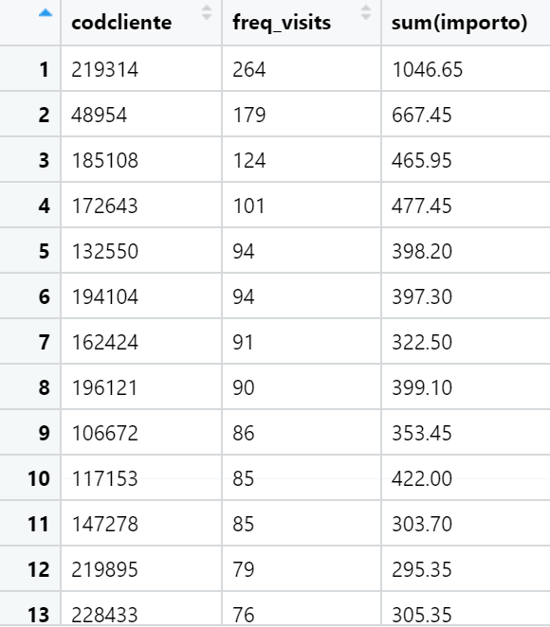
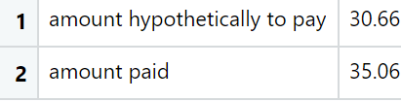
Secondary Analysis Continued
Amount that each customer would have needed to pay otherwise is given in the following table
Mean amount each customer would have paid if not bought the subscription vs import already paid
Rudimentary Profit Analysis
The profit while compared to associationpayment of 50%, comes out to be 60.89%, considering the sum(importo) and sum(associationpayment)

Slide 16
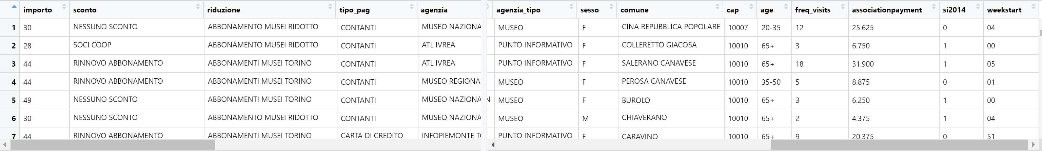
Join, clean and derived data columns
All derived columns from an13, in13 and data1 combined together using joins on codice cliente. Rbind customers who are not in in13(no visits)
Subsequent cleaning performed to remove unnecessary columns.
Convert date subscription to weekly
Final data form is given as follows
SQL code:
i5<-sqldf("select * from an5 as A,i4 as I
ON A.codcliente=I.codcliente")
i5<-i5[,-13]
View(i5)
##now do another join to concatenate data1 dataframe to know who churned and who did not
total<-sqldf("select * from i5 as A,data1 as D ON A.codcliente=D.codcliente")

Slide 17
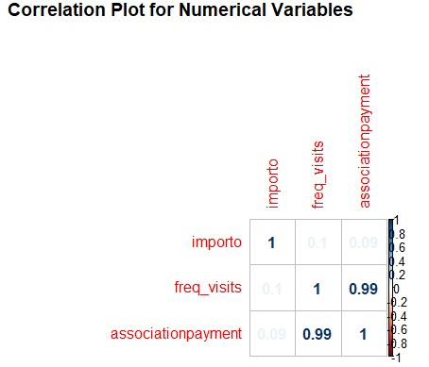
Correlation Analysis
Thus from the correlation plot, we can say that freq_visits are strongly correlated to associationpayment, while importo is not correlated to both, freq_visits and association payment
Correlation freq_visits and import 0.0985448
So we select association payment and importo as numerical variables
Subsequently change si2014 with Churn column which states if the customer churned or not
R Code:
train$importo<-as.numeric(train$importo)
train$freq_visits<-as.numeric(train$freq_visits)
numeric.var <- sapply(train, is.numeric)
corr.matrix <- cor(train[,numeric.var])
corrplot(corr.matrix, main="\n\nCorrelation Plot for Numerical Variables", method="number")
cor(train$freq_visits,train$importo)

Slide 18
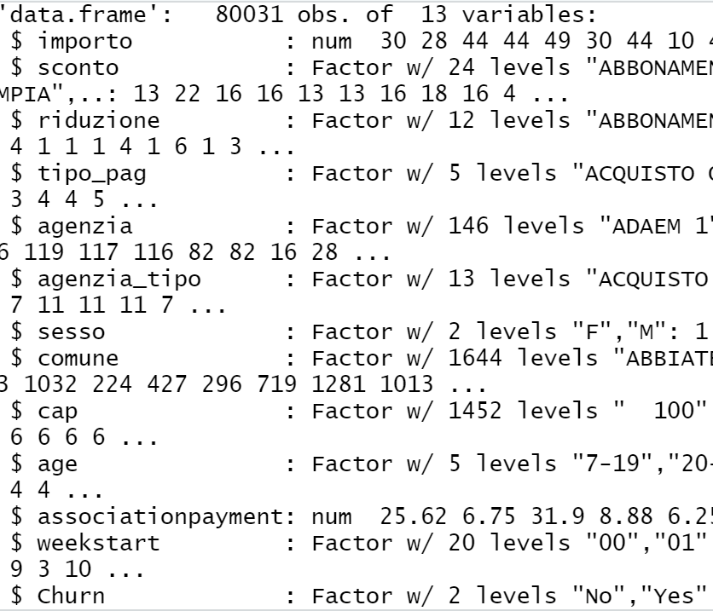
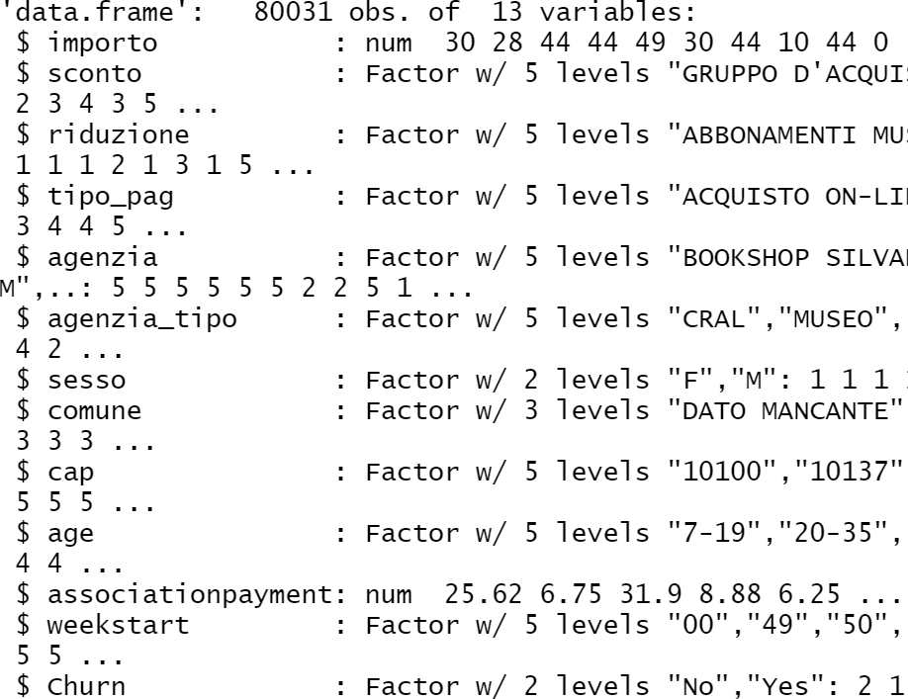
Lumping Factors
As can be seen from the str(main), the data frame has many factors levels specially in commune, cap, agenzia
This form will make it very difficult to form any predictive model
We choose fct_lump() function to get a selected number of factor levels based on the data distribution
New data structure is shown on the bottom right
R Code:
train$agenzia<-fct_lump(train$agenzia,n=4)
train$agenzia_tipo<-fct_lump(train$agenzia_tipo,n=4)
train$cap<-fct_lump(train$cap, n=4)
train$comune<-fct_lump(train$comune, n=2)
train$weekstart<-fct_lump(train$weekstart, n= 4)
train$sconto<-fct_lump(train$sconto, n=4)
train$riduzione<-fct_lump(train$riduzione, n=4)

Slide 19
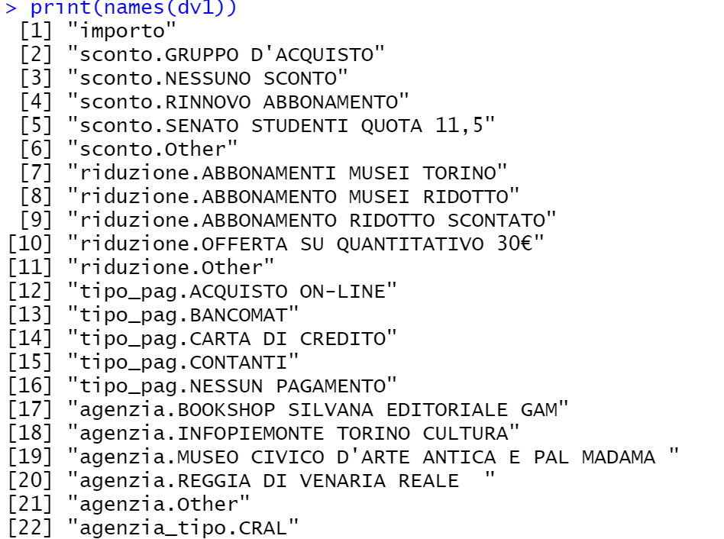
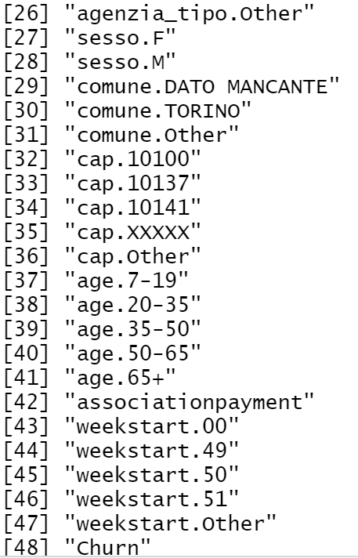
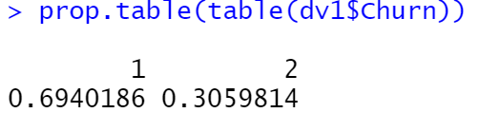
Dummy Variables
To further get the data in a workable form, we use dummy variables to convert the dataframe.
Moreover, we perform a Churn proportion check to see how it is distributed in the rows. Around 70%-30% (No-Yes)
R Code:
train$Churn<-as.integer(train$Churn)
View(train)
str(train)
dummy <- dummyVars("~.",data=train, fullRank=F)
dv1 <- as.data.frame(predict(dummy,train))
print(names(dv1))
prop.table(table(dv1$Churn))

Slide 20
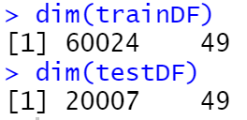
Data Split
Performing data split
Checking if split is successful
Storing separately clientIDs
R Code:
set.seed(1234)
splitIndex <- createDataPartition(dv1[,outcomeName], p = .75, list = FALSE, times = 1)
trainDF <- dv1[ splitIndex,]
testDF <- dv1[-splitIndex,]
dim(trainDF)
dim(testDF)
#removing and storing clientids of both separately
cidtrain<-trainDF$codcliente
cidtest<-trainDF$codcliente
trainDF$codcliente<-NULL
testDF$codcliente<-NULL

Slide 21
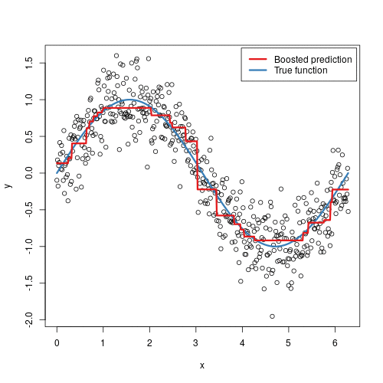
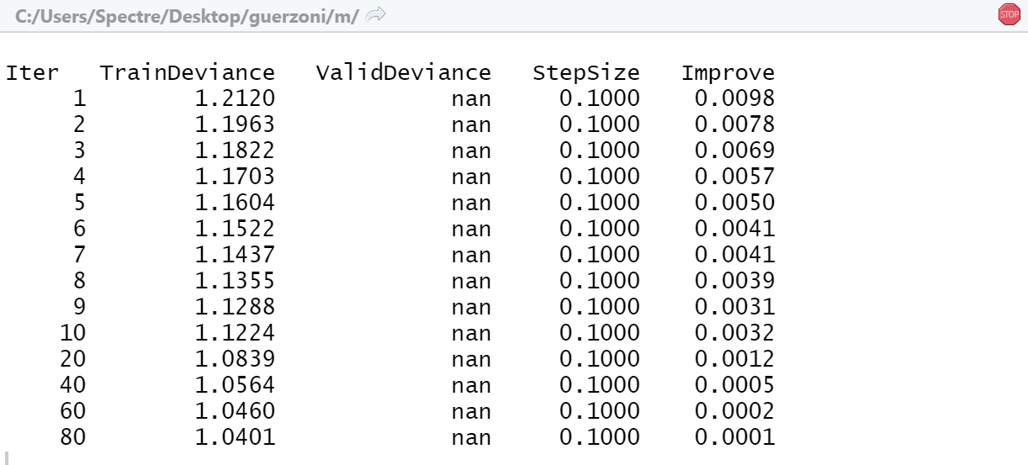
Modelling- Gradient Boosting Machines
Choice of model
Often provides high predictive accuracy as shown on the right
Flexibility- can optimize on different loss functions and provides several hyperparameter tuning options that make the function fit very flexible.
No data pre-processing required - often works great with categorical and numerical values as is.
Handles missing data - imputation not required.
Checks if split is successful
Flow
Generalize Outcome and PredictorNames
Create caret trainControl object to control the number of cross-validations performed
Run Model
R Code:
objControl <- trainControl(method='cv', number=3, returnResamp='none', summaryFunction = twoClassSummary, classProbs = TRUE)
objModel <- caret::train(trainDF[,predictorsNames], as.factor(trainDF[,outcomeName]),
method='gbm',
trControl=objControl,
metric = "ROC",
preProc = c("center", "scale"))

Slide 22
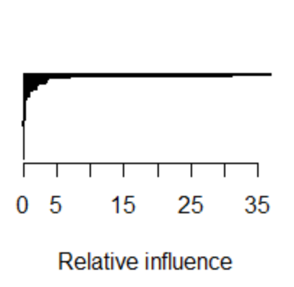
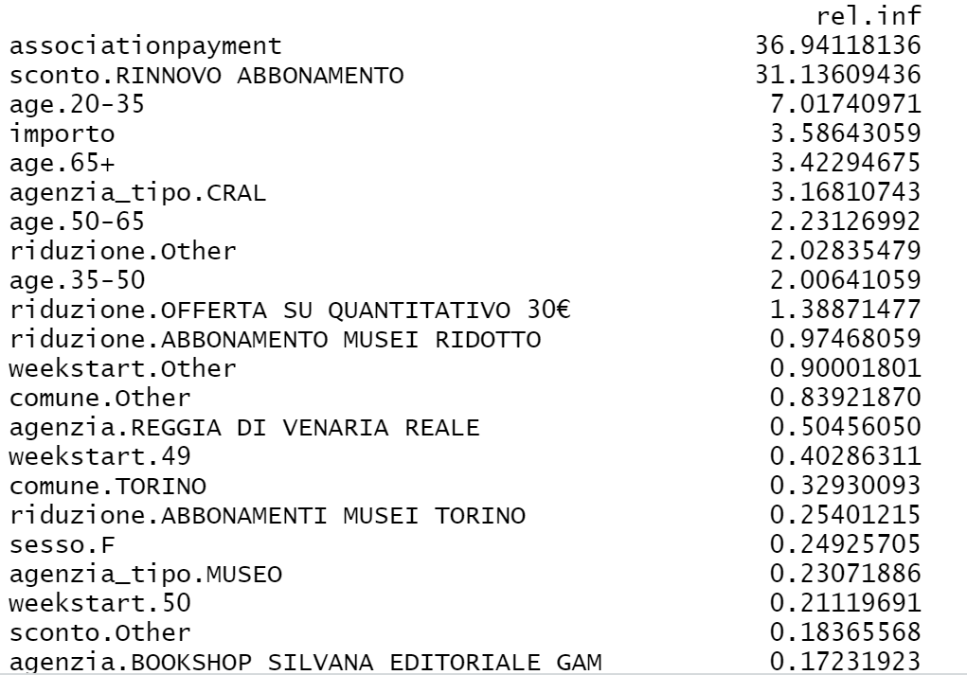
GBM- Churn Relative Influencers
Summary of the GBM shows us that Churn decision was most influenced by association payment, sconto, age, importo, agenzia, in the given order.
Thus, it can be said that the more that customers with high associationpayment attached to them Churned more. Similarly, Churn also depended on Rinnovo Abbonamento or the amount of Importo paid
R Code:
summary(objModel)
# find out model details
##gbm takes interaction depth, no. of trees and shrinkage.
##best tuning parameter
objModel

Slide 23
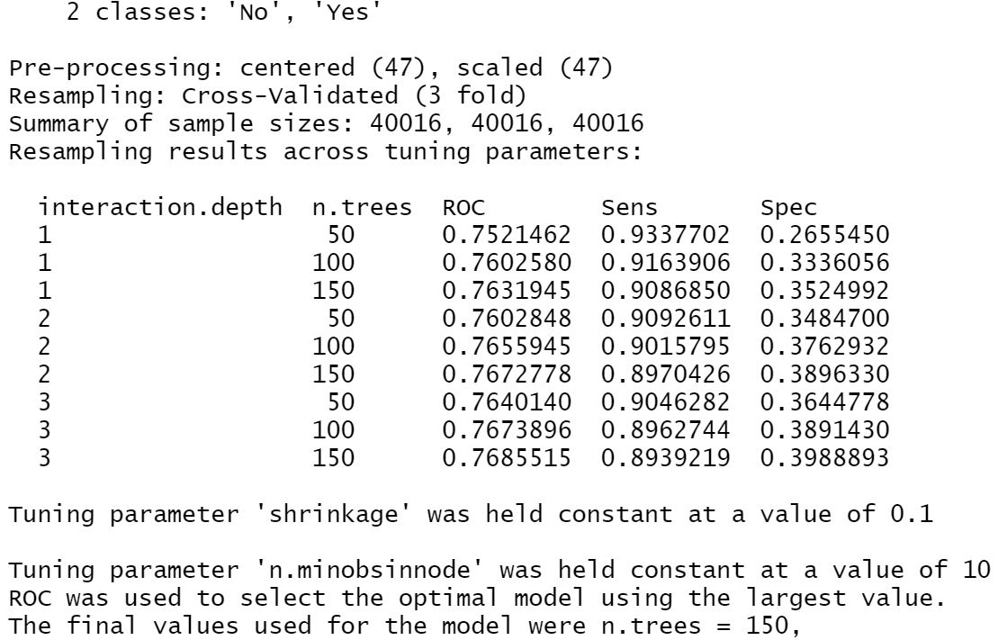

GBM- Model Details
Stochastic GBM
Model accuracy of 74%
60,024 samples, 47 predictor classes, Outcome of 2 classes
No. of trees=150, interaction depth=3 and shrinkage=0.1
R Code:
objModel
predictions <- predict(object=objModel, testDF[,predictorsNames], type='raw')
head(predictions)
print(postResample(pred=predictions, obs=as.factor(testDF[,outcomeName])))

Slide 24
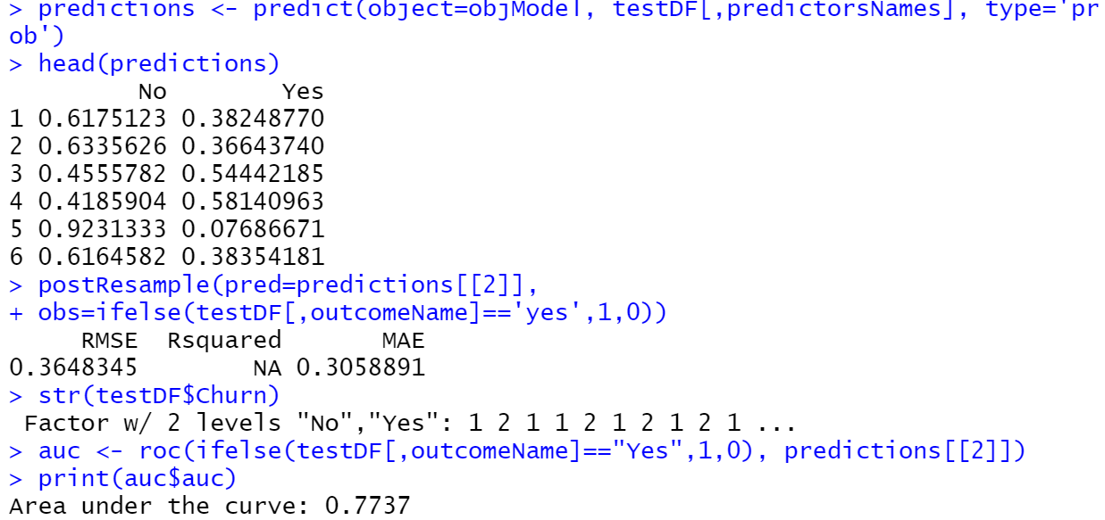
GBM- Model Details
If the Churn predictive model is used to get the probability of Churn
Given the noise in the dataset, we can say that the Root Mean Square Error and Mean Absolute Error Values are acceptable for this model.
Moreover, Area Under The Curve suggests a predictive accuracy of 77% on the test data
R Code:
# probabilites
library(pROC)
predictions <- predict(object=objModel, testDF[,predictorsNames], type='prob')
head(predictions)
postResample(pred=predictions[[2]],
obs=ifelse(testDF[,outcomeName]=='yes',1,0))
str(testDF$Churn)
auc <- roc(ifelse(testDF[,outcomeName]=="Yes",1,0), predictions[[2]])
print(auc$auc)

Slide 25
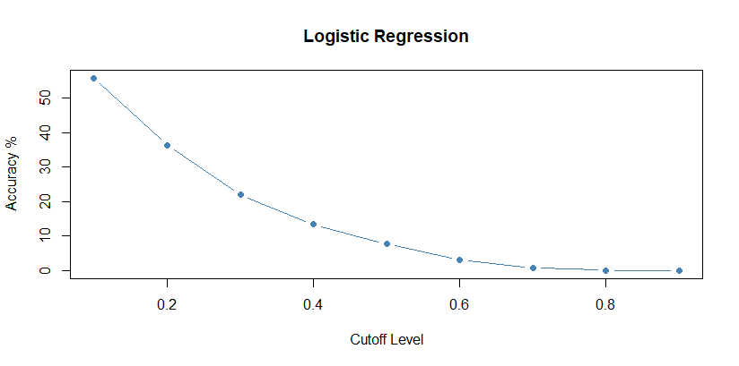
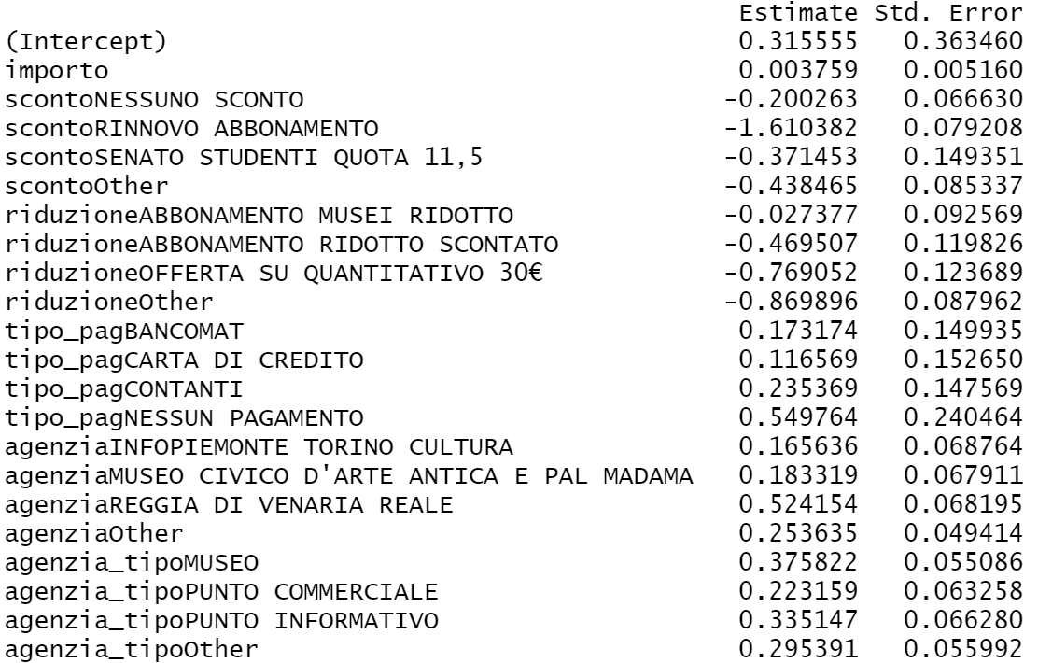
Modeling- Logistic Regression
Choice of model:
The model is more explanative than other classification algorithms. It tells us the correlation of each independent variable with the dependent variable
GLM model with dummy variables does not converge
GLM without the dummy variables converges and has its highest accuracy of around 55% at a cutoff level of 0.1
Consequently, performing significance tests shows that Churn depends on similar categories as in GBM Model
R Code:
LR <- glm(Churn~.,family=binomial(link="logit"),data=trainDF)
print(summary(LR))
View(LR)
anova(LR, test="Chisq")

Slide 26
Other Classification Models
EV Tree
Advantages and Disadvantages
Is recursive partitioning method that manufacture the model in a forward stepwise search. In spite of the fact that this methodology is known to be an effective heuristic
Modelling function stopped after one hour
Probable reason for long computations times can be the use of numerical variables such as importo and associationpayment.
A possible solution could be binning of these numerical variables but given the distribution of these variables, it was chosen to abandon this route.
kNN
Advantages and Disadvantages
Finds the nearest neighbour of a point in order to help categorize it.
Training function has the option to normalize numerical data
Needs dummy variables as input
Long model running time required
R Code:
library(evtree)
evt<-evtree(Churn~.,data=evtrain)
anova(LR, test="Chisq")
R Code:
caret::trControl2<-trainControl(method="repeatedcv",number=10,repeats=3)
knnfit<-caret::train(Churn ~.,data=knntrain,method='knn',tuneLength=20,
trControl=trControl2, preProc=c("center","scale"))

Slide 27
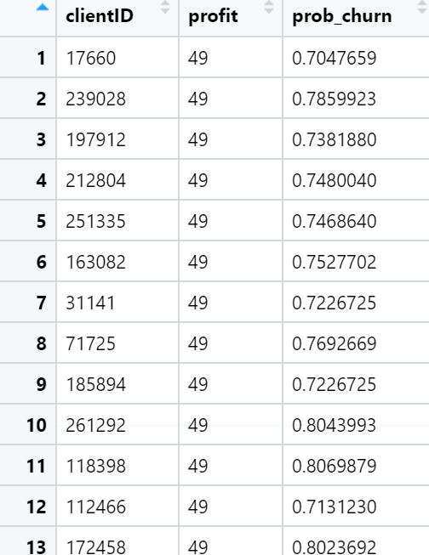
Profit Optimization
Model Selected:
Given the speed of training, testing and the accuracy of the Gradient Boosting Machine Model
Maximization of profit means calling customers with highest probability to churn but at the same time, those who are the most profitable
budget=$5000 can be translated as calling 5000 customers
At the end of the Churn classification using GBM, we choose to select top 5000 customers who are the most profitable and have high probability of churn to contact for marketing.
R Code:
#Selecting top 5000 customers to contact given prediction
testDF$clientID<-cidtest #read clientID
testDF$prob_churn<-predictions$Yes #prob of prediction
testDF$profit<-testDF$importo-testDF$associationpayment #individual customer profit
###############CUSTOMERS TO CONTACT FOR THE CAMPAIGN
customers_to_contact<-sqldf("select clientID,profit from testDF order by profit DESC
limit 5000")
View(customers_to_contact)

Slide 28
Conclusion
Model Selected:
Given the speed of training, testing and the accuracy of the Gradient Boosting Machine Model
Maximization of profit means calling customers with highest probability to churn but at the same time, those who are the most profitable
budget=$5000 can be translated as calling 5000 customers
At the end of the Churn classification using GBM, we choose to select top 5000 customers who are the most profitable and have high probability of churn to contact for marketing.
R Code:
#Selecting top 5000 customers to contact given prediction
testDF$clientID<-cidtest #read clientID
testDF$prob_churn<-predictions$Yes #prob of prediction
testDF$profit<-testDF$importo-testDF$associationpayment #individual customer profit
###############CUSTOMERS TO CONTACT FOR THE CAMPAIGN
customers_to_contact<-sqldf("select clientID,profit from testDF order by profit DESC
limit 5000")
View(customers_to_contact)

Slide 29
RESULTS AND CONCLUSION
2 levels of analysis performed
Churn predictive model generated with 77% accuracy
Limitations of the analysis
Recommendations
$
$
Predictive model that intrinsically accounts for the Expected Profit and Optimizes that as well
It would be interesting to cluster the categorical data based on k-modes and consequently use an additive predictive model
Churn division
70%-30%
No Churn vs Churn
Secondary analysis mainly uses age as groups distribution
Age, Gender, Importo
These factors have major impact on Churn
Try different levels of analysis as primary such as customer location
Tipo pagamento online usage is low
Minimum customers used this method.
Inter-relation of customers not considered
Visualize others perspectives as well.
Predictive Model helps select customers for the marketing campaign
Gradient Boosting Model predicts churn probabilities of each customer

Slide 30
THANKS FOR YOUR ATTENTION

